Slide 1

New England Hospital Security
An assessment of the New England Hospital overviewing:
- Security issues
- Vulnerabilities
Mitigation strategies
(Talk about what it is, 1st of its kind, opened Maidstone Kent, 4 may 2022 services for covid and provides 300 beds for rehabilitation)

Slide 2
Hospital IT Infrastructure
(Services operating on)
Workstations using Windows 8 or 10
Servers working on Windows 2016, 2019
Legacy Windows XP systems
Online Web Services via Internet to access records
(Patient Information held on)
Linux based SQL servers
J2EE Java Glass Fish application servers
(Login system built through Java Resource Adapter Architecture)
Active directories, web servers, SQL databases

Slide 3
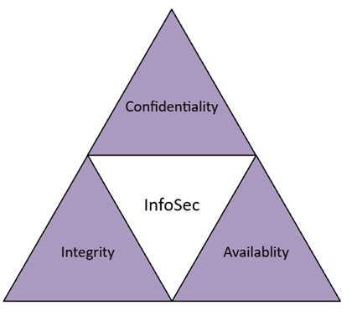
Security Requirements
(Prime target for attacks due to
value and importance)
Keep data secure (and protected
against internal or external damage)
Reduce Risk of security breaches
Maintain the principles of CIA

Slide 4
Risk assessment

Slide 5
Risk matrix

